Slide 1
Analytical Methods for Business
Dr. Ronald K. Satterfield
Muma College of Business
University of South Florida

Slide 2
Time Series Modeling Regression with Time as the X
Dr. Ronald K. Satterfield
Muma College of Business
University of South Florida

Slide 3

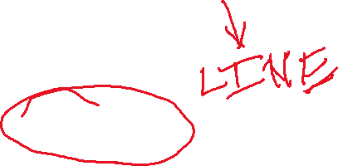




Plan for This Presentation
What is a Time Series?
Components of a Time Series
Really Basic Demonstration
Secular Trend Only
The Durbin-Watson Test & Statistic
Approaches for Handling Cyclicality
Seasonal Indices
Just a Little Trigonometry
Comparing Approaches
Introduction | Demonstrations | More Complexity | Durbin-Watson
Seasonal Indices | Some Trigonometry | Nonlinearity? | Conclusion

Slide 4
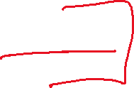
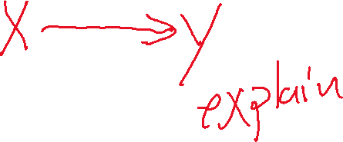
What is a Time Series
A time series is a collection of data obtained by observing a dependent variable at periodic (usually equally spaced) points in time.
Introduction | Demonstrations | More Complexity | Durbin-Watson
Seasonal Indices | Some Trigonometry | Nonlinearity? | Conclusion

Slide 5
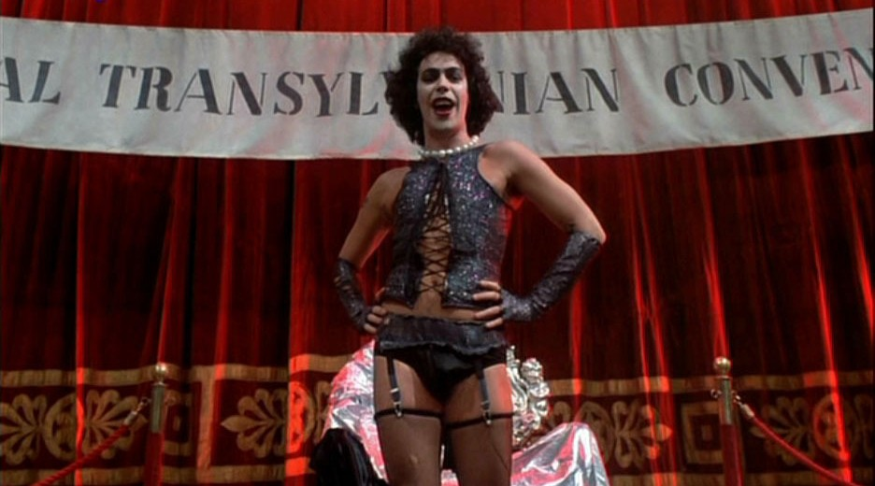
Time Series “Let’s do the time-warp again”
Introduction | Demonstrations | More Complexity | Durbin-Watson
Seasonal Indices | Some Trigonometry | Nonlinearity? | Conclusion
Notes:
5

Slide 6
Time Series “Let’s do the time-warp again”
It’s a jump to the left
And then a step to the right
With your hands on your hips
You bring your knees in tight
But it's the pelvic thrust
That really drives you insane
Let's do the time-warp again
Introduction | Demonstrations | More Complexity | Durbin-Watson
Seasonal Indices | Some Trigonometry | Nonlinearity? | Conclusion
Notes:
6

Slide 7

Time Series Components
Secular Trend: The long-term trend. The tendency of a variable to increase or decrease regularly over a extended time periods.
Cyclical Effect: Describes a fluctuation around a secular trend. Usually the cyclical effect is regular or semi-regular and occurs over an extended time.
Seasonal Variation: Similar to a cyclical effect, but occurring over a shorter time such as one year.
Introduction | Demonstrations | More Complexity | Durbin-Watson
Seasonal Indices | Some Trigonometry | Nonlinearity? | Conclusion

Slide 8
An Excel Example
Introduction | Demonstrations | More Complexity | Durbin-Watson
Seasonal Indices | Some Trigonometry | Nonlinearity? | Conclusion
Notes:
8

Slide 9
“Let’s Do the Time Series Again” (in R)
Introduction | Demonstrations | More Complexity | Durbin-Watson
Seasonal Indices | Some Trigonometry | Nonlinearity? | Conclusion
Notes:
9

Slide 10
Gold Price Data
Introduction | Demonstrations | More Complexity | Durbin-Watson
Seasonal Indices | Some Trigonometry | Nonlinearity? | Conclusion
Notes:
10

Slide 11
Milk Price Data Basic Regression
Introduction | Demonstrations | More Complexity | Durbin-Watson
Seasonal Indices | Some Trigonometry | Nonlinearity? | Conclusion
Notes:
11

Slide 12
The Durbin-Watson Test
A Test of Autocorrelation. Testing the “I” in LINE.
Introduction | Demonstrations | More Complexity | Durbin-Watson
Seasonal Indices | Some Trigonometry | Nonlinearity? | Conclusion
Notes:
12

Slide 13
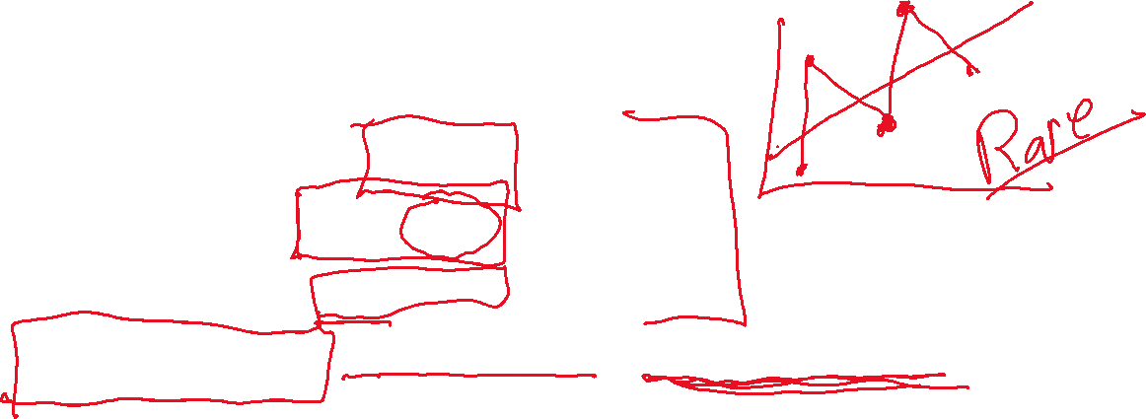
The Durbin-Watson Test
A Test of Autocorrelation. Testing the “I” in LINE.
Ranges from 0 to 4
2 means no autocorrelation (1.5 to 2.5 is “normal”)
Approaching 0 means positive serial autocorrelation
Approaching 4 means negative serial autocorrelation
Hypothesis test with Ho: No autocorrelation, Ha: There is autocorrelation
Introduction | Demonstrations | More Complexity | Durbin-Watson
Seasonal Indices | Some Trigonometry | Nonlinearity? | Conclusion
Notes:
13

Slide 14
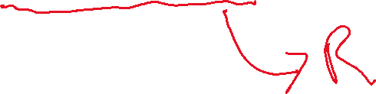
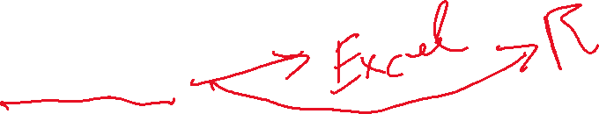
Milk Price Data Exhibits Seasonal Fluctuations
An Approach Using Seasonal Indices
An Approach Using Trigonometric Functions
Introduction | Demonstrations | More Complexity | Durbin-Watson
Seasonal Indices | Some Trigonometry | Nonlinearity? | Conclusion
Notes:
14

Slide 15
Seasonal Indices Demonstrated in Excel
Introduction | Demonstrations | More Complexity | Durbin-Watson
Seasonal Indices | Some Trigonometry | Nonlinearity? | Conclusion
Notes:
15

Slide 16
Seasonal Indices Operationalized in R
Introduction | Demonstrations | More Complexity | Durbin-Watson
Seasonal Indices | Some Trigonometry | Nonlinearity? | Conclusion
Notes:
16

Slide 17
Seasonal Indices The Trigonometric Approach
Introduction | Demonstrations | More Complexity | Durbin-Watson
Seasonal Indices | Some Trigonometry | Nonlinearity? | Conclusion
Notes:
17

Slide 18
Seasonal Indices Cycles Interacting with Time?
Introduction | Demonstrations | More Complexity | Durbin-Watson
Seasonal Indices | Some Trigonometry | Nonlinearity? | Conclusion
Notes:
18

Slide 19
Seasonal Indices A Squared Term for a Non-Linear Secular Trend?
Introduction | Demonstrations | More Complexity | Durbin-Watson
Seasonal Indices | Some Trigonometry | Nonlinearity? | Conclusion
Notes:
19

Slide 20



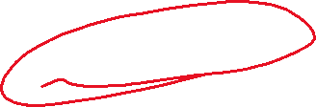

What Have We Done?
Define a Time Series
Components of a Time Series
Really Basic Demonstration
Secular Trend Only
The Durbin-Watson Test & Statistic
Approaches for Handling Cyclicality
Seasonal Indices
Just a Little Trigonometry
Compared Approaches
Introduction | Demonstrations | More Complexity | Durbin-Watson
Seasonal Indices | Some Trigonometry | Nonlinearity? | Conclusion

